Slide 1
TEACHER ONLY — hidden in slideshow
Y9 · Ecosystems L3 of 3 · 50 minutes
Round and round: carbon, nitrogen, and why the mud is full of both
PRIOR KNOWLEDGE
MISCONCEPTIONS (wrong → right)
LESSON FLOW (50 min)
• Lesson 1: ecosystem, abiotic/biotic, producer / consumer / decomposer. The gold forest at Tung Prong Thong was short of NITROGEN — today is the payoff for that.
• Lesson 2: energy flows one way and is lost as heat. Today is the contrast.
• Y7 Unit 3 (Earth's Fresh Water): they have already done the water cycle properly — evaporation, condensation, precipitation. Use it as the model they already own and say so.
• Y8 / Y7 Cells: photosynthesis and respiration equations. They need both today, so put them on the board before the bell.
EAL note: "fix" in "nitrogen fixation" has nothing to do with repairing. Say that out loud once — it confuses fluent speakers too.
✗ "Matter and energy both go round."
→ Energy flows through ONCE and leaves as heat. Matter cycles. This is the whole lesson.
✗ "A tree gets its carbon from the soil."
→ Almost all of it comes from CO₂ in the air. The mass of that tree came out of the sky. Expect real resistance; it is worth the two minutes.
✗ "Plants get their nitrogen straight from the air."
→ The air is 78% nitrogen and almost no plant can touch it. Bacteria have to fix it first.
✗ "Decomposers destroy the dead stuff."
→ Nothing is destroyed. They release it. Atoms are conserved.
✗ "If it is a cycle, everything keeps moving."
→ Mangrove mud holds carbon for centuries. A cycle can have a very slow lane, and that is what blue carbon is.
✗ "Only animals respire."
→ Plants respire too, day and night. Otherwise the carbon cycle on slide 7 has no return arrow from the producers.
Do Now — 5
Hook: why has the nitrogen not run out? — 4
I Do: flows vs cycles — 4
I Do: the carbon cycle — 6
We Do: follow the atom — 5
I Do: the nitrogen cycle — 6
We Do: the gold forest, solved — 4
You Do: worksheet — 11
Reveal: the slow lane — 3
Plenary: true / false — 2
──────────────
TOTAL 50 min
SCOPE: this delivers your objective 5 and closes the three-lesson sequence.
CURRICULUM NOTE, worth knowing: your pasted objectives came from CK-12 19.1, which the attached SoW maps to Y9 Unit 2. Biogeochemical cycles are CK-12 19.4, which the SoW puts in Y9 UNIT 4 (Ecosystem Dynamics, 5 hours). So this lesson is really Unit 4's opening lesson pulled forward to finish your objective list. When you reach Unit 4, start at biomes and succession — do not teach the cycles twice. Unit 3 (18.1–18.3) also overlaps Lessons 1 and 2 heavily.
IF YOU ARE SHORT OF TIME: cut the nitrogen cycle to the fixation step only and set the rest as the worksheet Gold. Do not cut the reveal — it is where the sequence lands.
SENSITIVE CONTENT — slide 14. Carbon credits and a petrochemical industry that many Rayong families work in. Present the science as settled and the policy as contested, because that is the honest position.
Notes:
Hidden slide — it will not appear in the slideshow. Print it or keep it open on the second screen.

Slide 2
Y9 SCIENCE · ECOSYSTEMS · LESSON 3 OF 3
Round and
round
The energy ran out in four steps. The atoms never do.
The nitrogen in a mangrove leaf has been round this estuary thousands of times.
Pak Nam Prasae · Klaeng · Rayong
Notes:
TITLE — arrive on this.
The motif completes the sequence: Lesson 1 gave you the tree, Lesson 2 bent the sunlight into arrows stepping down, and today those arrows close into a loop. Let it finish before you speak.
SAY: "Last lesson ended with a question I refused to answer. The energy runs out after four or five steps. So why, after ten thousand years, has this estuary not run out of nitrogen?"
TIMING: 30 seconds. The question is the hook and it is on slide 5 — do not answer it here.

Slide 3
OBJECTIVES · 1 MIN
Today, and how you will know you got there
LESSON OBJECTIVES
SUCCESS CRITERIA — tick these off yourself
1.
Explain the difference between something that flows through an ecosystem and something that cycles round it.
I can say in one sentence why energy does not cycle but carbon does.
I can say where a mangrove tree gets the carbon it is built from.
2.
Outline how carbon moves round the Prasae estuary, using photosynthesis, respiration and decomposition.
I can name the process that turns nitrogen gas into something a plant can use.
I can follow one carbon atom all the way round and back to where it started.
3.
Outline how nitrogen moves round, and use it to explain why the trees at Tung Prong Thong are gold.
I can explain the gold leaves at Tung Prong Thong using the nitrogen cycle.
This is the last of three. By the end you will have answered the question from Lesson 1.
Notes:
OBJECTIVES — 1 minute. Two clicks.
SAY: "Criterion two looks trivial and it is the one most adults get wrong. Where does the wood in a tree come from? Hold that."
Criterion five is the Lesson 1 question. Point at it and remind them you promised an answer three lessons ago.
They fill the START column of the RAG grid now.

Slide 4
DO NOW · 5 MIN
Do Now
Books open. Answer all six. Four minutes, then we mark them together.
1
Write the word equation for photosynthesis.
2
Write the word equation for respiration.
Carbon dioxide + water → glucose + oxygen (using light).
Glucose + oxygen → carbon dioxide + water (releasing energy).
3
What happens to the energy at every step of a food chain?
4
What job do decomposers do?
About nine tenths is lost, mostly as heat.
They break down dead material and release the nutrients.
5
Name the three stages of the water cycle you learned in Year 7.
6
A mangrove tree weighs two tonnes. Where did that mass come from?
Evaporation, condensation, precipitation.
Keep whatever you wrote. We settle it today.
Notes:
DO NOW — 5 minutes: 4 working, 1 marking. Six clicks, one answer each.
Q1 and Q2 are load-bearing. If the room cannot write both equations, slow down and rebuild them together — the carbon cycle on slide 7 IS those two equations drawn as a loop, and it will not land otherwise.
Q5 is deliberate: they did the water cycle in Year 7 and they own it. You are going to borrow its shape twice today.
Q6 IS THE LESSON. Do NOT settle it now. Take a straw poll: soil, water, or air. Nearly every class votes soil. Write the tally on the board and say "one of these rooms is about to be very surprised." You come back to it on slide 7.
MISCONCEPTION on Q4: "they eat the dead things". Close, but the word that earns the mark is RELEASE — what they put back is the point of today.
STRETCH: "Q1 and Q2 are almost the same equation backwards. Why is that not a contradiction?" — different conditions, different places, different energy direction. Thirty seconds, no more.

Slide 5
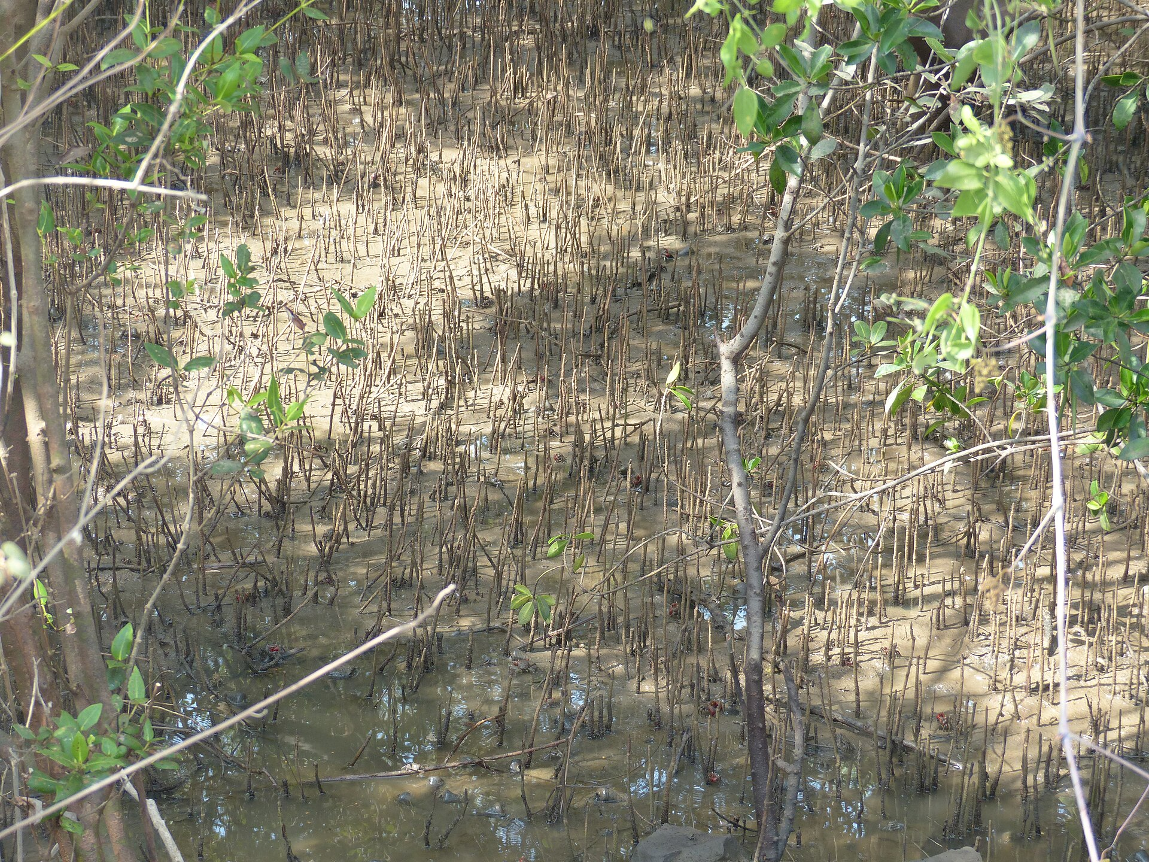
HOOK · 4 MIN
So why has it not run out?
Last lesson: energy arrives from the Sun, passes along four or five links, and leaves as heat. It is gone.
The Prasae estuary has been running for thousands of years. Every leaf that ever grew there needed nitrogen.
So why has the estuary not run out of nitrogen?
A
The tide keeps washing fresh nitrogen in from the sea.
Pneumatophores pushing up through waterlogged mangrove mud. Photo: Dinesh Valke, CC BY-SA 2.0.
B
The same nitrogen atoms get used again and again.
C
Mangroves do not really need much nitrogen.
Vote. Write your letter in the margin.
Notes:
HOOK — 4 minutes. Three clicks: the setup, the question, then the options staggered.
Take the vote by hands and record it next to the Q6 tally.
ANSWER: B, and you can give it at the end of this slide rather than holding it — the interesting part today is not WHICH answer but HOW the cycle works.
A is not silly: tides do move nutrients about, and mangroves really do trap sediment. But moving nitrogen from one place to another does not create any. Say that — it is the distinction between a source and a transfer.
C is flatly wrong and Lesson 1 proved it: the trees at Tung Prong Thong are gold precisely BECAUSE they are short of nitrogen. If anyone votes C, that is the link to make.
STRETCH: "Where did the nitrogen atoms come from in the first place, before any of this?" — the atmosphere, and before that, stars. Do not follow it far.

Slide 6
I DO · 4 MIN
flows · cycles
One goes through. The other goes round.
ENERGY — flows through, once
MATTER — goes round, for ever
Sun
Producers
Consumers
In the air
In a plant
In dead matter
In an animal
HEAT
It leaves the ecosystem and does not come back. That is why you need the Sun again tomorrow.
No atom is ever used up. The same atoms have been round this estuary more times than anyone could count.
Notes:
I DO — 4 minutes. Six clicks: the energy panel builds left to right, then heat leaves; then the matter panel builds as a closed loop.
EXACT WORDING, and it is the sentence of the lesson: "Energy is spent. Matter is borrowed."
The two diagrams are doing the teaching, so let them look. Point at the left one: the line has an end. Point at the right one: there is no end, only a next step.
CALL BACK to Year 7: the water cycle they already know has exactly this shape. Say so — you are not teaching a new idea, you are teaching two new examples of an idea they own.
MISCONCEPTION: "so the ecosystem could run without the Sun, if the matter keeps going round". No — the matter cycles BECAUSE energy keeps pushing it round. Stop the energy and the loop stops. Good students will ask this; it is worth 30 seconds.
STRETCH: "Which law of physics is the right-hand picture?" — conservation of mass.

Slide 7
I DO · 6 MIN
carbon cycle · photosynthesis · respiration
Carbon, round the Prasae estuary
PHOTOSYNTHESIS
takes carbon out of the air
CO₂ in the air
Producers
and dissolved in the water
mangrove, phytoplankton
RESPIRATION AND
DECOMPOSITION
put it back
FEEDING
Dead leaves and bodies
Consumers
Locked in the mud
in the mud
crabs, fish, egrets
for centuries
DEATH AND WASTE
and some never leaves
Where the mass of a tree comes from: the air. Not the soil.
Notes:
I DO — 6 minutes. Seven clicks: CO₂ first, then each arrow-label-box step round the loop, then the locked-in-the-mud box, then the banner.
GO BACK TO DO NOW Q6 before you build. The tally on the board almost certainly says soil. Build the loop, then click the banner and let it land.
EXACT WORDING: "That two-tonne tree is made of carbon it took out of the sky, one molecule at a time, through holes in its leaves. The soil gave it water and a few minerals. The MASS came from the air."
Expect disbelief. It is the single most satisfying fact in Year 9 biology. Let them argue for a minute.
MISCONCEPTION: only decomposers return carbon. No — the producers and the consumers are respiring the whole time, day and night. The arrow labelled RESPIRATION AND DECOMPOSITION covers both; say that explicitly or they will think plants only photosynthesise.
DO NOT DWELL on the gold "locked in the mud" box yet. Introduce it, say "hold that thought", and move on. It is the reveal on slide 14.
STRETCH: "If photosynthesis and respiration are opposites, why is there any carbon left in living things at all?" — because photosynthesis runs slightly ahead. That surplus is the whole food chain from Lesson 2.

Slide 8
WE DO · 5 MIN
carbon cycle
Follow one carbon atom
Whiteboards. Where does it go NEXT? Hold them up together on three.
The atom is in a CO₂ molecule above the estuary. A mangrove leaf opens its pores.
Into the leaf
Photosynthesis. It becomes part of a glucose molecule, then part of the wood.
The leaf falls into the mud. A ปูแสม crab eats it.
Into the crab
Feeding. The crab builds some of it into its own body and breathes the rest out.
The crab breathes out.
Back to the air
Respiration. Straight back to CO₂ — this atom has done one lap already.
A different atom is in a crab that dies and sinks into waterlogged mud.
It stays put
Decomposers need oxygen, and there is almost none down there. It can sit for centuries.
Row 4 is the odd one out. Notice what it does not do.
Notes:
WE DO — 5 minutes. Eight clicks: destination then reason, row by row. Boards up BEFORE you click.
Rows 1 to 3 are one atom doing a complete lap in about a year. Say that out loud when row 3 lands: "that is a full circuit, and it happens constantly."
ROW 4 IS THE PIVOT of the lesson, and the footer tells them to look for it. The answer is that nothing happens. Ask: "Why can the decomposers not get at it?" Waterlogged mud has almost no oxygen, so decomposition nearly stops.
MODEL ANSWER for the follow-up "so is that still a cycle?" — yes, but with a very slow lane. Some carbon comes back in a day, some in a thousand years.
MISCONCEPTION on row 3: students say "the crab turns it into energy". No. It releases energy FROM it; the carbon atom is unchanged and leaves as CO₂. Matter and energy are different things — that is slide 6 again.
IF THE ROOM IS SECURE by row 2, take rows 3 and 4 as whole-class discussion rather than boards.

Slide 9
I DO · 6 MIN
nitrogen cycle · nitrogen fixation
Nitrogen: the one that needs a doorman
NITROGEN-FIXING BACTERIA
the only ones with the key
TAKEN UP
by the roots
N₂ gas in the air
Usable nitrogen
Producers
78% of every breath
nitrates in the mud
mangrove, phytoplankton
DECOMPOSERS put it back
FEEDING
Dead matter and waste
Consumers
leaves, bodies, droppings
crabs, fish, egrets
DEATH AND WASTE
The air is 78% nitrogen and almost nothing alive can use it. Bacteria in the mud break the N₂ apart and hand it over — they supply between 40% and 60% of all the nitrogen a mangrove forest needs.
Notes:
I DO — 6 minutes. Seven clicks: the air first, then the fixation step, then round the loop one arrow at a time, then the note.
START WITH THE ODDITY: "You are breathing nitrogen right now. Four out of every five molecules going into your lungs. And you cannot use a single one of them." That lands every time.
THE METAPHOR on the slide is the doorman: N₂ is a locked molecule and only the bacteria have the key. Push them to say "fixing means making it usable", not "fixing means repairing".
THE 40–60% FIGURE is measured, not a guess — biological fixation supplies that share of a mangrove forest's nitrogen. Mangrove mud is genuinely nitrogen-limited, which is why the fixers matter so much there.
MISCONCEPTION: "so plants get nitrogen from the air". They do not, directly. The nitrogen comes from the MUD; it only got there because bacteria put it there.
MODEL ANSWER for "why do farmers add fertiliser?" — to skip the bacteria. That is the Haber process, and it is Y10 chemistry. Flag it, do not teach it.
STRETCH: "Which arrow would you cut to kill the forest fastest?" — the fixing arrow. Nothing else replaces it.

Slide 10
WE DO · 4 MIN
Lesson 1, finally answered
Tung Prong Thong: the same species, the same sun, forty minutes from this room — and gold leaves.
1
The ground there is a sandbank, not deep estuary mud.
Sand drains. It holds very little dead organic matter, so there is little for decomposers to work on.
2
Less dead matter means less nitrogen being returned.
The decomposer arrow on the last slide is the thin one here. The loop is running, but it is running on empty.
3
The trees cannot build enough chlorophyll.
Chlorophyll molecules contain nitrogen. No nitrogen, no chlorophyll.
4
Less chlorophyll means yellow-gold leaves and stunted trees.
Green is the colour of chlorophyll. Take it away and the yellow shows through.
Explained in 2023 by Assoc. Prof. Dr Kitichate Sridith, Prince of Songkla University — the sandbank is nitrogen-poor.
Notes:
WE DO — 4 minutes. Eight clicks: heading then explanation, step by step. Ask the class for each step BEFORE you click it.
This is the payoff for the whole sequence, so do not rush it. In Lesson 1 you told them the answer was "something in the ground". Today they can say exactly what, and why, using a cycle they drew twenty minutes ago.
PROMPT FOR STEP 1: "What is different about the ground at Tung Prong Thong?" They met this on Lesson 1 slide 14.
PROMPT FOR STEP 3: "What does a plant need nitrogen FOR?" Push until someone says chlorophyll or protein. Both are right.
MISCONCEPTION: "the trees are dying." They are not. They are stunted and they flower and reproduce perfectly well. Worth correcting because it matters for how students argue about conservation later.
IF A STUDENT ASKS why the bacteria do not just fix more nitrogen there — excellent question, and the honest answer is that fixation is slow and expensive for the bacteria, and a drained sandbank is a poor home for them. Say you are not certain of the detail; that is a true and useful thing for them to hear.

Slide 11
YOU DO · 11 MIN
On your own — worksheet, Section A to C
Start where you like. Move up when a question stops being hard.
BRONZE
SILVER
GOLD
Fluency
Mixed practice
Reasoning
Label the cycles. Get the two equations and the vocabulary secure.
Follow atoms round. Apply the cycles to a new situation.
Explain, predict and justify. Full sentences.
Stuck, or finished early? Use Gemini properly.
The three prompts are on the last page of your worksheet — copy and paste them. One quizzes you on the two cycles, one checks an explanation you have written, one marks your Gold answer against the criteria. None of them will write an answer for you, and I can tell. Check everything it says against your own notes.
RAG grid, front page — fill in the "end of lesson" column before you pack away.
Notes:
YOU DO — 11 minutes. No clicks.
CIRCULATE WITH ONE QUESTION: "Point at the arrow you are describing." If they cannot point, they are writing words rather than following a cycle.
WHERE THEY WILL STALL: B3 (the numeracy on percentages of carbon in the soil) and C4 (why draining a mangrove releases carbon). For C4 tell them to look at the gold box on slide 7 and ask what happens when the mud stops being waterlogged.
LEAVE SLIDE 7 OR 9 ON THE BOARD if you can — a cycle diagram is a reference, not a secret.
AT 3 MINUTES REMAINING, stop them wherever they are. The reveal is worth more than three more minutes of writing.

Slide 12
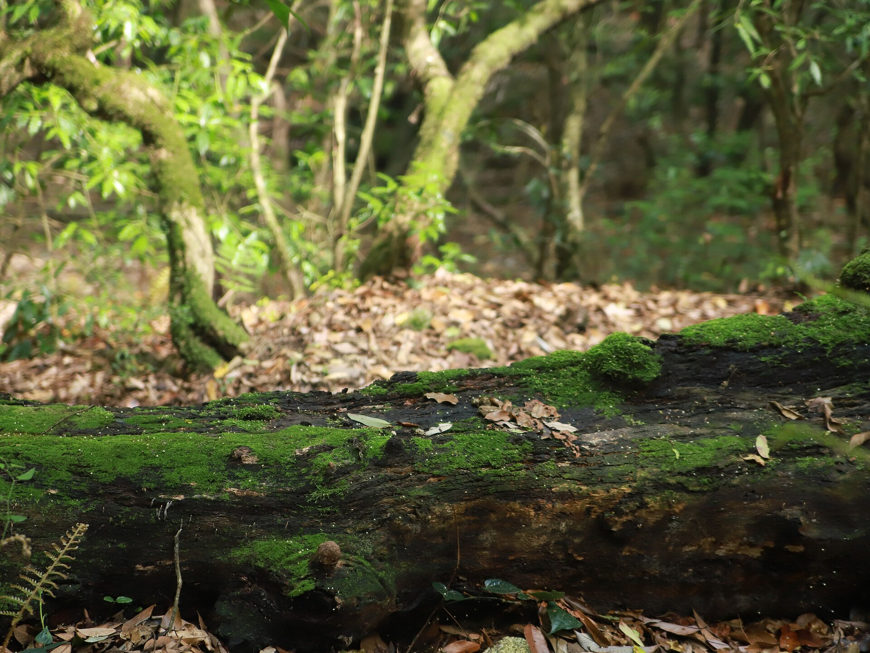
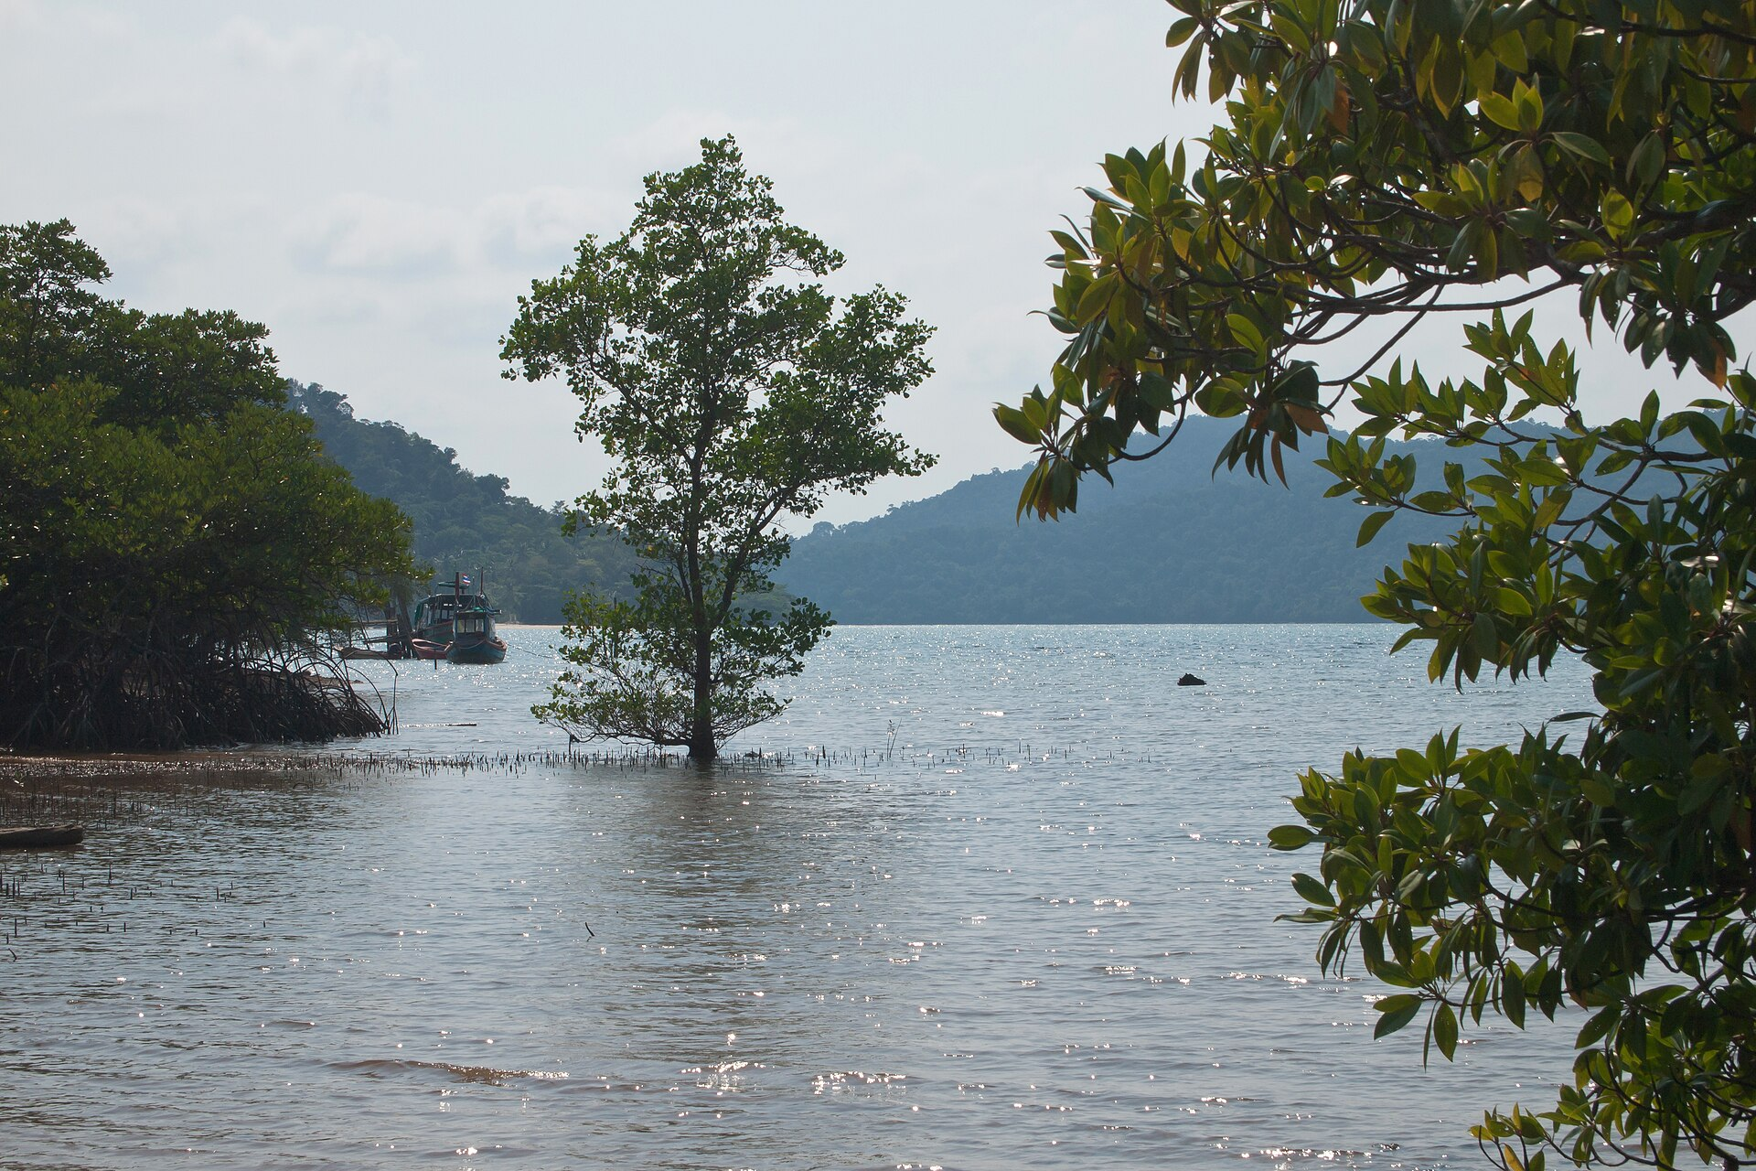
REVEAL · 2 MIN
Two places a dead leaf can land
A rotting log on a dry forest floor — plenty of oxygen, so decomposers get to work and the carbon is back in the air within a few years. This one is a temperate forest, not a mangrove. Photo: Krishna k. sahh, CC0.
Mangrove at Ko Chang, Thailand. Below that waterline the mud is waterlogged and almost oxygen-free, so the same leaf barely rots at all. Photo: Vyacheslav Argenberg, CC BY 4.0.
Same leaf. Same decomposers. The difference is the oxygen in the ground.
Notes:
REVEAL, part one — 2 minutes. Three clicks: each photo with its caption, then the banner.
NOTE THE HONEST CAPTION. The left-hand photo is a temperate forest floor, not a tropical one, and the caption says so. It is there for the contrast, not as a picture of Rayong. If a student notices before you say it, credit them.
SAY: "Decomposition is respiration. Respiration needs oxygen. Waterlogged mud has almost none, so the process nearly stops — and the carbon just sits there."
This is the mechanism behind row 4 of the We Do. Link it back explicitly.
STRETCH: "What else does this explain?" — peat bogs, and ultimately coal. A coal seam is a carbon cycle that got stuck for three hundred million years.

Slide 13
REVEAL · 1 MIN
blue carbon
So the mud is the real forest
1,023
49–98%
up to 5×
~10%
tonnes of carbon per hectare
of it is in the soil
more than a rainforest
of deforestation emissions
Measured across 25 mangrove forests in the Indo-Pacific. Among the most carbon-rich forests on Earth.
Not in the trees. In the mud beneath them, sometimes three metres deep.
Per hectare, mangroves store several times the organic carbon of tropical upland forest.
Mangroves are 0.7% of tropical forest area, but clearing them releases roughly a tenth of all deforestation carbon.
The carbon cycle has a slow lane, and Rayong is sitting on it. Chalome’s villagers did not just replant trees — they restarted a carbon store.
Figures: Donato et al. 2011, whole-ecosystem carbon in 25 Indo-Pacific mangrove forests.
Notes:
REVEAL, part two — 1 minute. Five clicks: the four numbers, then the closing line.
Do not read all four cards aloud. Click them, let them look, and land on card 2 — "the forest you can see is the smaller half of the forest."
THE CALL-BACK matters: Chalome Wongthim from Lesson 1 pushed seedlings into the mud to bring the crabs back. He was also, without knowing the word, rebuilding a carbon store. Three lessons, one estuary.
HONESTY: 1,023 tonnes per hectare is an average across 25 forests and the range is wide. Say "about a thousand" rather than implying precision.
STRETCH: "If the soil holds the carbon, does planting new trees on bare tidal flat help as much as protecting old forest?" — genuinely debated, and the evidence leans towards protecting what is already there. A good answer is "protect first, plant second".

Slide 14
CONTEXT · 2 MIN
What happens when mud becomes money
The science is settled. What to do about it is not.
What Thailand is doing
Why people disagree about it
In 2022 the Department of Marine and Coastal Resources opened mangrove planting to companies who want carbon credits — a ten-year programme across 23 coastal provinces.
In 2023 coastal communities were invited in too. Around 34,000 hectares are registered so far, with a target of 80,000 by 2031. Communities keep 20% of the credits.
FOR: mangroves were being cleared for decades and nobody paid to stop it. Now there is money to protect them, and communities get a share.
AGAINST: measuring how much carbon a forest actually holds is hard, most of the credit goes to the companies, and a credit lets a business keep emitting somewhere else.
Both of those are true at the same time. That is what makes it an argument rather than a mistake.
Sources: DMCR programme announcements 2022; reporting by Dialogue Earth / Pulitzer Center, 2024.
Notes:
CONTEXT — 2 minutes. Three clicks: what is happening, then the two sides of the argument.
SENSITIVE — read the teacher slide. Rayong is a petrochemical province; Map Ta Phut is down the road and some of your students have a parent working there. Several of the companies buying these credits are in exactly that industry.
HOLD THE LINE between the two halves of the slide: the carbon numbers on slide 13 are measurements and are not in dispute. Whether carbon credits are a good idea is a political question, and reasonable people disagree. Do not tell them what to think, and do not pretend there is nothing to argue about either.
IF A STUDENT ASKS what you think — it is fine to say that this is one where your job is to make sure they can argue it properly, not to hand them your answer.
THE SCIENCE QUESTION worth asking: "What would you have to measure to check a mangrove really stored the carbon someone was paid for?" Soil depth and soil carbon content, repeatedly, over years. That is genuinely difficult, and it is the strongest version of the AGAINST case.
CUT THIS SLIDE FIRST if you are behind. It is context, not curriculum.

Slide 15
SUMMARY · 1 MIN
Three lessons, one estuary
LESSON 1
LESSON 2
LESSON 3
What an ecosystem is
How the energy flows
How the matter cycles
Living and non-living, interacting. Producers, consumers, decomposers. And a gold forest we could not explain.
One way only, from the Sun along four or five links, losing nine tenths at every step, and gone as heat.
Round and round, for ever, driven by that energy — with carbon stuck in the mud and bacteria unlocking the nitrogen.
Energy is spent. Matter is borrowed. Everything else in ecology is detail.
Notes:
SUMMARY — 1 minute, folded into the plenary time. Four clicks.
This is the slide to photograph. Tell them so.
SAY the banner sentence out loud and make them say it back. "Energy is spent. Matter is borrowed." If they remember one thing from three lessons, that is the one worth having.
The last line is a deliberate overstatement and a good student will push back on it. Let them — population, competition and succession are all still coming. Agreeing with a student who catches you exaggerating is worth more than the exaggeration.

Slide 16
PLENARY · 2 MIN
True or false?
Stand up for TRUE. Stay sitting for FALSE. No fence-sitting.
1. Energy cycles round an ecosystem, just like carbon does.
FALSE
Energy flows through once and leaves as heat.
2. Most of the mass of a mangrove tree came out of the air.
TRUE
Carbon dioxide, through the leaves.
3. Plants take nitrogen straight from the air.
FALSE
Bacteria have to fix it into the mud first.
4. Decomposers destroy the matter in dead leaves.
FALSE
They release it. Nothing is destroyed.
5. In a cycle, every atom keeps moving at the same rate.
FALSE
Some carbon sits in mangrove mud for centuries.
That is the unit. Next: what happens when one population grows too fast.
Notes:
PLENARY — 2 minutes. Eleven clicks: each statement, then its verdict and reason together, then the closing line.
Every false statement here is a misconception from the hidden teacher slide. Q2 is the only TRUE one and it is deliberately the one that feels wrong — if half the room stays sitting, that is the sentence to put in next lesson's Do Now.
THE MOTIF FINISHES HERE: same tree from Lesson 1, same sun, and the arrows now closed into a loop. Nobody will mention it. It still works.
CLOSING LINE points at the rest of Unit 2 — human population and the goldfish-cracker tragedy-of-the-commons activity in the scheme of work. That is the practical this unit has been saving up.
THE SEQUENCE IS DONE. Objectives 1 to 5 are all delivered.

Slide 17
Credits and sources
IMAGES — all Creative Commons or public domain
Avicennia pneumatophores in mud
Dinesh Valke · CC BY-SA 2.0 · Wikimedia Commons
Mangrove trees, Ko Chang, Thailand
Vyacheslav Argenberg · CC BY 4.0 · Wikimedia Commons
Decaying log on a forest floor (temperate)
Krishna k. sahh · CC0 · Wikimedia Commons
SOURCES
Mangrove carbon: 1,023 t C per hectare, 49–98% in soil
Donato et al., Mangroves among the most carbon-rich forests in the tropics, 2011
Up to 5× the organic carbon of upland tropical forest
Donato et al. 2011, via Frontiers in Marine Science, 2022
Nitrogen fixation supplies 40–60% of mangrove nitrogen
Peer-reviewed studies of diazotrophs in mangrove sediments, 2021–2023
Mangrove sediments are nitrogen-limited
The ISME Journal, nitrogen fixation in mangrove sediments, 2024
Thai mangrove carbon credit programme, 2022 and 2023
DMCR announcements; reporting by Dialogue Earth / Pulitzer Center, 2024
Gold leaves at Tung Prong Thong
Assoc. Prof. Dr Kitichate Sridith, Prince of Songkla University, via Sarakadee, 2023
Objectives and vocabulary
CK-12 Lesson 19.4 · GIS KS3 SoW, Y9 Term 1.1
Notes:
Not shown in the lesson unless someone asks. Kept in the file so the licences and the numbers travel with the deck if you share it.

